Slide 1

PROJECT ENGINEERING AND MANAGEMENT
Course Code: CH62028
Class:
Dr. SUVERNA TRIVEDI
Assistant Professor
Department of Chemical Engineering, IIT KGP
Email: strivedi@che.iitkgp.ac.in

Slide 2
Topic To be Covered
Basic of process plant
Basic Aspect of Process design
Selection of process equipment & utilities
Plant location layout and site selection
Engineering Economics

Slide 3
Recommended Books
Text Books:
Peters – Timmerham, Plant Design, and Economics for Chemical Engineers, McGraw Hill Book Co, 2017.
F. C. Viberandt and C. E. Dryden, Chemical Engineering Plant Design, McGraw Hill Book Co, 1959
SUPPLEMENTARY READING
Frederick Plummer, Project Engineering (The Essential Toolbox for Young Engineers), Butterworth-Heinemann, 1st ed. 2007.
V.V. Mahajani and S.M. Mokashi, Chemical Project Economics, Laxmi Publications, Second edition (1 June 2016)

Slide 4
Marks Distribution
Mid Semester : 30 Marks
End Semester: 50 Marks
Teaching Assessment: 20 Marks [(10 Marks-Suverna)+(10 Marks-Prof JC)]
# Suverna TA: Any time surprise test

Slide 5
Learning Objectives
By the end of this course, you should be able to:
To design and develop chemical process flow sheets.
To do cost estimation, feasibility analysis, economic analysis.
To familiarize the concepts of optimum economic designs.
To identify the importance of project management.

Slide 6

1. Real-World Project Failures and Successes
Project Background
Location: Sydney, Australia
Architect: Jørn Utzon, a Danish architect
Initial Concept: Designed as a performing arts center, with unique sail-like structures inspired by nature and geometry.
What Went Wrong?
Initial Cost Estimate:
The project was estimated to cost $7 million.
Actual Cost: By completion in 1973, it had cost over $100 million—14 times the original estimate.
Time Overruns:
Estimated Time to Completion: 4 years
Actual Time: It took 14 years (1959 to 1973).
Design and Engineering Challenges:
Utzon’s design was chosen without fully understanding its structural feasibility.
No prior calculations were done to prove the design was buildable with the technology of the time.
The roof sails’ complex geometry required innovative engineering, which significantly delayed construction.
Sydney Opera House

Slide 7
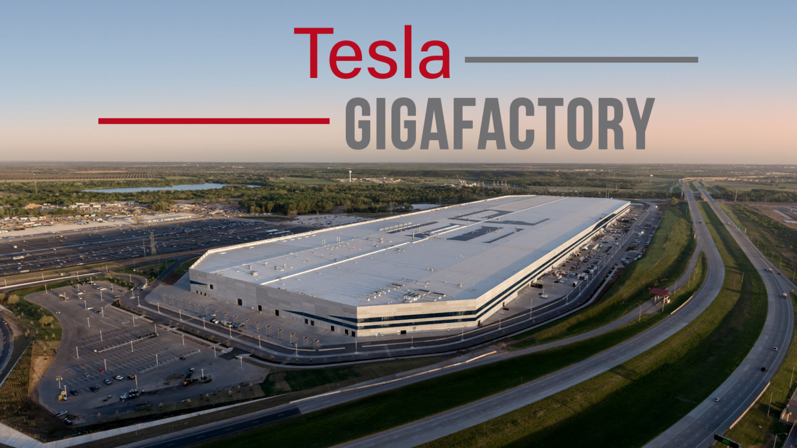
1. Real-World Project Failures and Successes
Background
Location: Sparks, Nevada, USA
Size: One of the largest buildings in the world by footprint (expected to cover 5.8 million square feet when fully completed).
Purpose: Mass production of lithium-ion batteries for Tesla’s electric vehicles and energy storage products.
Inception: Construction began in 2014, with production starting in 2016.
Goals and Vision
Cost Reduction: Reduce battery costs by 30% through economies of scale, vertical integration, and automation.
Sustainability: Operate using renewable energy to achieve net-zero energy use.
Capacity: The factory aims to produce 35 GWh of battery capacity per year, enough for 500,000 electric cars annually.

Slide 8
Key Challenges and Innovations
Massive Scale and Construction Phases:
Unlike traditional projects, the Gigafactory was designed to be built in phases, allowing production to start while construction continued.
Lesson: Phased construction reduces delays and starts revenue generation early.
Location Selection:
Nevada was chosen for its proximity to key resources, access to transportation routes, and generous state tax incentives.
Lesson: Strategic location planning can significantly reduce logistics costs and enhance profitability.
Vertical Integration:
Tesla integrated multiple processes, from raw material processing to battery cell production, under one roof.
Lesson: Vertical integration helps control quality, reduce costs, and streamline supply chains.
Automation and Advanced Manufacturing:
Use of cutting-edge robotics and automation to optimize efficiency.
Lesson: Investment in automation can reduce labor costs and increase production speed.

Slide 9
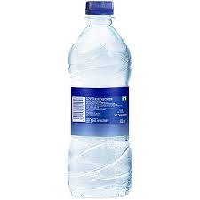
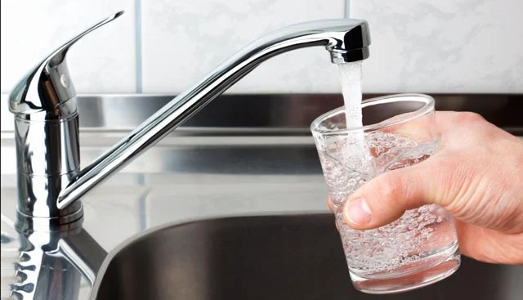
2. Everyday Engineering in Action
WATER BOTTLE
TAP WATER
Tap Water Cost: In most developed regions, tap water costs about $0.01 to $0.05 per liter due to government-subsidized infrastructure for water purification and distribution.
Bottled Water Cost: Bottled water can cost between $1 to $5 per liter, depending on brand and packaging. This is 100 to 500 times more expensive than tap water.

Slide 10
2. Everyday Engineering in Action
Scenario: "You are tasked with designing a new bottled water company. How would you optimize production to reduce costs while maintaining quality?"
Questions:
"What factors contribute the most to the cost difference between bottled and tap water?"
"What project management strategies could you implement to reduce packaging or transportation costs?"

Slide 11
2. Everyday Engineering in Action
Example 2: Choosing a Factory Location for Chocolate Production
Scenario: "Imagine you are building a chocolate factory. Where would you build it?"
Factors to Discuss:
Proximity to cocoa farms (raw materials).
Access to power and water.
Transportation to consumer markets.
Lesson: Introduce the concept of plant location and layout design.

Slide 12
3. Famous Chemical Engg Projects
Example 1: The Bhopal Gas Tragedy (1984)
Point: A chemical project failure with catastrophic consequences due to poor risk management.
Question: "What safety measures would you prioritize in designing a chemical plant?"
Connection: Stress the importance of safety, engineering ethics, and project evaluation.
Example 2: Development of Ammonia Production
Point: The Haber-Bosch process transformed agriculture by producing fertilizers.
Question: "How did ammonia synthesis impact food production globally?"
Connection: Illustrate how chemical process design affects economics and sustainability.

Slide 13

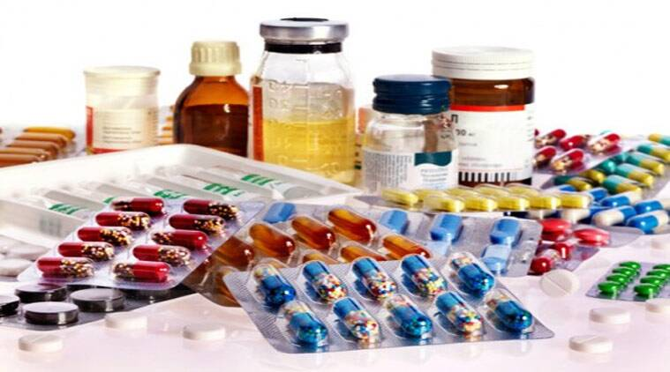



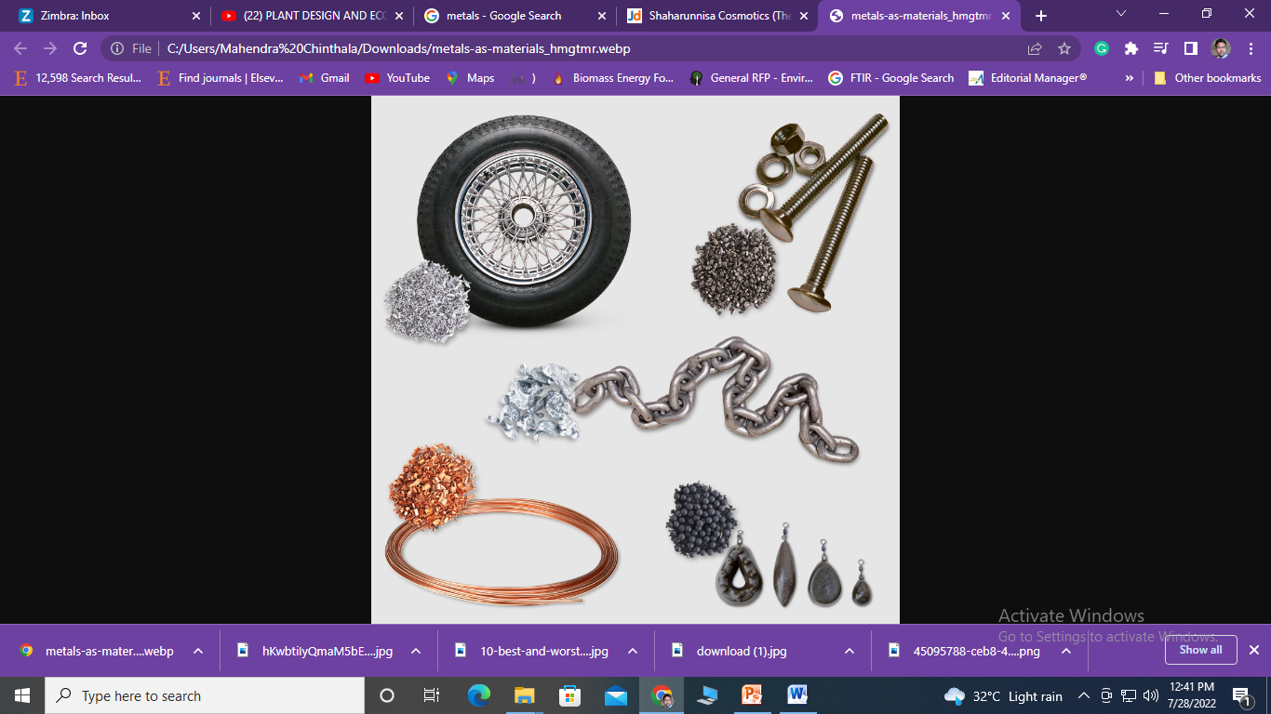
Importance of Chemicals

Slide 14


Classification of Chemicals
Chemical products are broadly classified into
Commodity chemicals ( > 100000 tons/year)
Fine chemicals ( >10000 tons/year)
Specialty or functional chemicals (1000 to 10000 tons/year)
Commodity/Bulk chemicals: are produced in large volumes and sold on their composition and purity. Ex: HCL, HNO₃, N₂, O₂, ethylene, Cl₂, etc.,
Fine chemicals: are produced generally fewer than 10000 TPA. Like commodity chemicals these are sold based on their composition and purity. Ex: Ammonia, urea, phenol, methanol, PVC, acetic acid, etc.,
Specialty chemicals: are manufactured for specific application. It is the function of these chemicals that determine their price rather than its chemical composition. Ex: Perfumes, sprays, particular pharmaceutical products, mosquito repellents, etc.,

Slide 15
Chemical Project/Chemical Process Plant
A chemical Process plant can be identified as a facility for physico-chemical or biological transformation of raw materials into value added products.
Various resources like manpower, utilities, energy, water, land and money are required for these transformation of raw materials into value added products.
Chemical Plant or process is a combination of various unit operations and unit processes.
Technical, commercial aspects along with the social requirements need to be considered during project evaluation.
Chemical plants should be socially acceptable and economically viable.

Slide 16
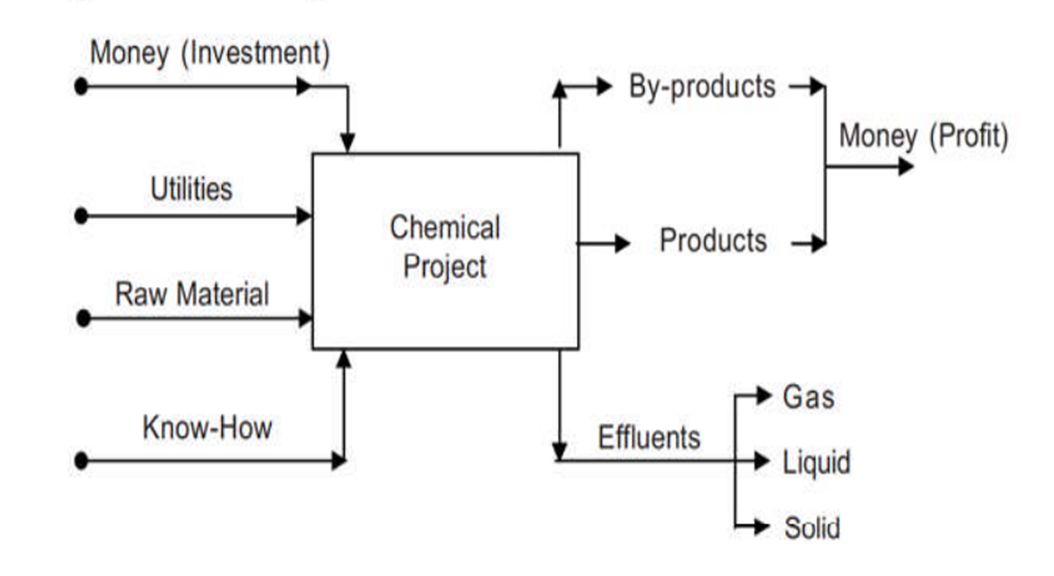
Chemical Project Model

Slide 17
Extended scope of Chemical Projects
The scope of chemical projects, nowadays, is extended even to
Power projects based on LNG
Cryogenic fuel manufacturing for space programme
Nuclear power plant
These considerations give a totally different dimension of safety, Health and Environment related issues to a chemical project.
Chemical plant requires not only the technical and commercial aspects but also social requirements.
This aspect needs a special attention in the setting up of chemical projects.

Slide 18



Project Engineering
Project Engineering is “ Successful implementation of an idea into reality”.
Success of a project is measured in three aspects:
Profits
Non-monetary returns
Social gains
Engineering of a chemical project consists of coordinated combination of technical and non-technical activities.
Technical activities in Project Engineering
System engineering
Equipment design
Material selection
Plant location and layout

Slide 19
Non-Technical Activities
Obtaining clearances from various authorities such as Pollution Control Board, the State Electricity board,
Procurement of land,
Arrangement of finance
Legal and statutory matters
Time factor
Time factor plays a major role in the success of Chemical Projects for three main reasons.
Long delays increase the interest on borrowings
Project extensions can change the market opportunities adversely.
Delays increase the project cost and affect the profitability.
Chemical projects, engineering and economics are not separable.

Slide 20

Types of Chemical Engineering Projects
Chemical Projects are classified into:
Green field (Grass root) Project
Add-on project
Gross root or Green field Project: Is a plant which is constructed from scratch or from procurement of barren land.
Add on project: They are built within an existing plant or built around the main project. It could be an addition of a new facility, a backward or forward integration.
Expansion of plant capacity depends on market forces.

Slide 21
Chemical Project Design
Conception of idea
Market potential
Technology search
Preliminary feasibility report to aid the investment
Detailed technology search and evaluation
Site selection
Preparation of detailed techno-economic feasibility report
Statutory clearness's or approvals from both state and central Govt.
Detailed Engineering
Project Financing
Project Engineering
Construction of plant, Procurement of instruments
Commissioning of plant

Slide 22
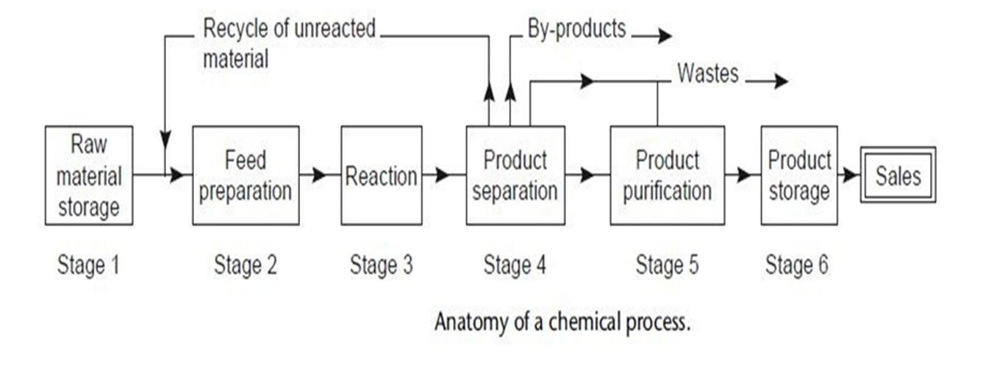
Chemical Process Design
Chemical Plants include a series of unit operations that convert raw materials into desired products.
Design of the manufacturing process of a chemical product should be done keeping its market and economics.

Slide 23
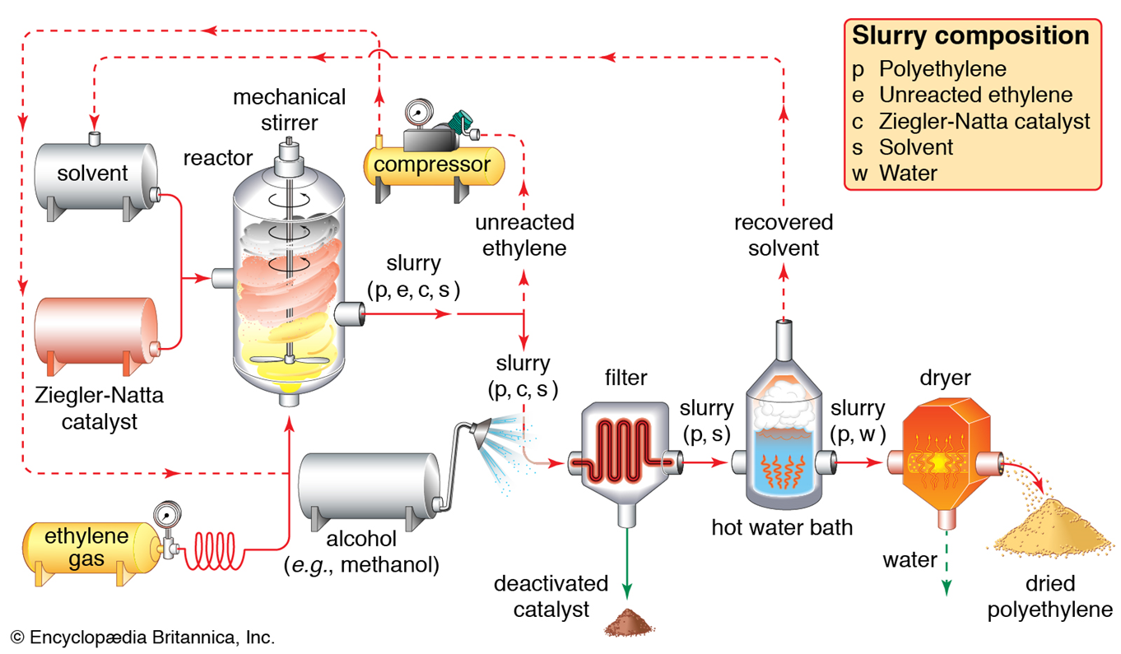
Chemical Process Design

Slide 24
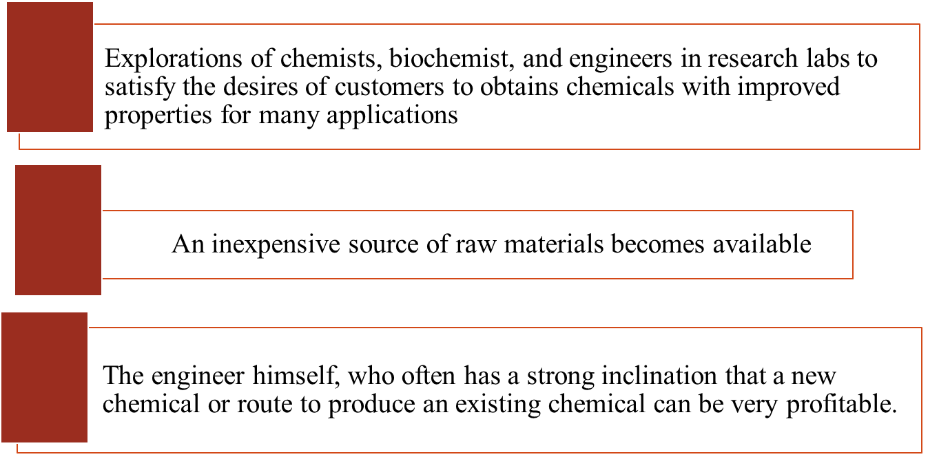
Origins of Design Problems

Slide 25
Cost Estimation
As soon as the final process design stage is completed, it becomes possible to make accurate cost estimations because detailed equipment specifications and definite plant facility information are available.
Direct price quotations based on detailed specifications can be obtained from various equipment vendors.
Evaluation of costs in the preliminary design phases is referred to as predesign cost estimation.
Such estimates should be capable of providing a basis for company management to decide whether further capital should be invested in the project.
Fixed costs, direct production costs for raw materials, labor, maintenance, power, and utilities must all be included along with costs for plant and administrative overhead, distribution of the final products, and other miscellaneous items.

Slide 26
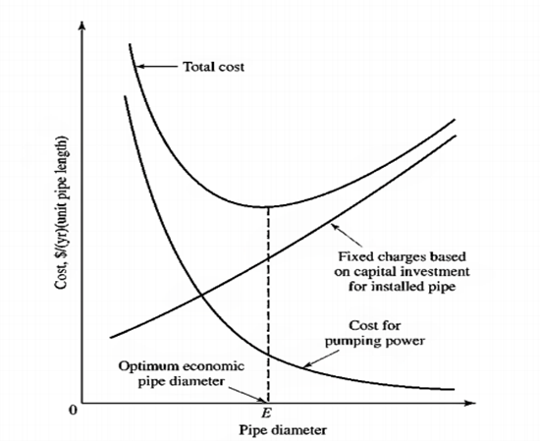


Optimum Economic Design
If there are two or more methods for obtaining exactly equivalent final results, the preferred method would be the one involving the least total cost.
This is the basis of an optimum economic design.
One typical example of an optimum economic design lies in determining the pipe diameter to use when pumping a given amount of fluid from one point to another.

Slide 27
Practical Considerations In Design
The chemical engineer must never lose sight of the practical limitations involved in a design.
It may be possible to determine an exact pipe diameter for an optimum economic design, but this does not mean that this exact size must be used in the final design.
Optimum diameter: 3.43 in. (8.71 cm) recommended pipe size:
standard 3 ½ in.-diameter pipe
Id: 3.55 in. (9.02 cm)

Slide 28
The Design approach
The general approach in any plant design involves a careful balanced combination of theory, practice, originality, and plain common sense.
Make assumptions & approximate estimates when exact values are not available in order to save time and energy.
Assumptions are made only when they are necessary and essentially correct.
The engineer must also consider costs and probable profits and economic conditions and limitations constantly throughout all the work.

Slide 29
Engineering Ethics In Design
The Code of Ethics adopted by the American Institute of Chemical Engineers is given below.
Hold paramount the safety, health, and welfare of the public in performance of their professional duties.
Formally advise their employers or clients
Accept responsibility for their actions and recognize the contributions of others
Issue statements or present information only in an objective and truthful manner.
Act in professional matters for each employer or client as faithful agents or trustees, and avoid conflicts of interest.
Treat fairly all colleagues and co-workers, recognizing their unique contributions and capabilities.
Perform professional services only in areas of their competence.
Build their professional reputations on the merits of their services.
Continue their professional development throughout their careers, and provide opportunities for the professional development of those under their supervision.

Slide 30
References
Text books:
1. Peters – Timmerham, Plant Design and Economics for Chemical Engineers, McGraw Hill Book Co , 2017
2. F. C. Viberandt and C. E. Dryden, Chemical Engineering Plant Design, McGraw Hill Book Co , 1959
Referernces
1. V.V. Mahajani & S. M. Mokashi, Chemical Project Economics, MacMillan INIDA
2. R. Smith, Chemical Process Design & Integration, John Wiley & Son
3. R.K. Sinnott, Chemical Engineering Design, Vol.6
4. J.M. Dougles, Conceputual Design & Chemical Processes, McGraw –Hill.

Slide 31
Thank you

